Slide 1
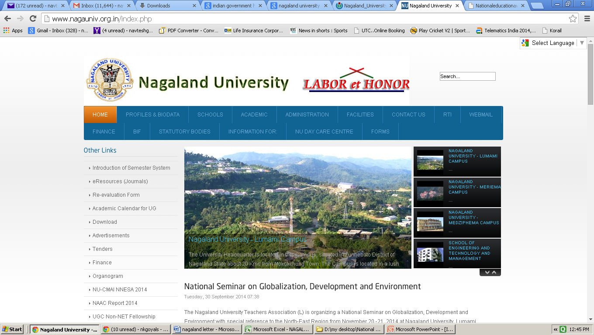










Nagaland University
Department of MNRE
Govt . Of India.
Department of MSME
Govt . Of India.
CMAI National Nagaland Education Summit & Awards 2014
Organized by – CMAI & Nagaland University
Supported By –AICTE, NIELIT, AIU
Govt. Of India, MNRE, DeIT, MSME
Media Partner

Slide 2


CMAI FLAGSHIPS EVENTS
NTA ICT World Communication Awards – Only Awards in India supported by Government of India MNRE, MSME etc, International Telecom Union, CTO, UK etc.
Only ICT Awards in world presented by Dr Hamadoun Toure, Secretary General International Telecom Union, Geneva two years in a row.
National Legal Education Summit & Awards - Only Awards in India supported by
Ministry of Law & Justice - Legislative Department and Department of Legal Affairs, National Law University, Bangalore and other Associations etc
National Performance Execution Summit & Awards supported by Govt. of India Department of Program Implementation
National PSU’s Summit & Awards supported by Govt. of India, Public State Enterprises Board.
The only Mobile Expo organize in India & China - ICOMM – India International Communications Fair ,

Slide 3
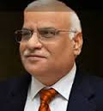
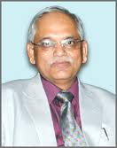
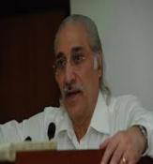
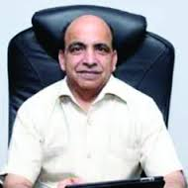
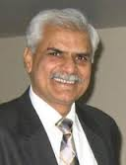
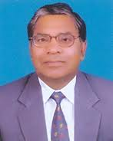

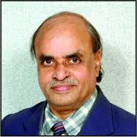

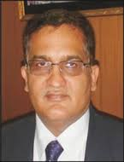
Vice Chancellors with whom CMAI is associated
Prof. DS Chauhan
Vice Chancellor
Uttarakhand Technical University, UK
Dr. Piyush Trivedi
Vice Chancellor
Rajiv Gandhi Proudyogiki Vishwavidyalaya, MP
Prof. SK Kak
Vice Chancellor
Mahamaya Technical University, UP
Dr. Rajneesh Arora
Vice Chancellor
Punjab Technical University Punjab
Dr. RK Khandal
Vice Chancellor
Uttar Pradesh Technical University, UP
Dr. ML Ranga
Vice Chancellor
Guru Jambheshwar University of Sci & Tech., Hisar
Prof. HS Chahal
Vice Chancellor
Maharishi Dayanand University
Prof. K Lal Kishore
Vice Chancellor
JNTU, Anantapur
Shri. Sudhir Kumar (IAS)
Vice Chairman
State Board of Technical Education,
Prof. Avinash C pandey
Vice Chancellor
Bundelkhand University, Jhansi
And More….

Slide 4
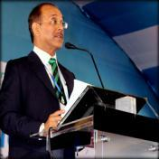
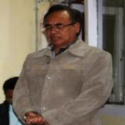
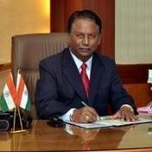
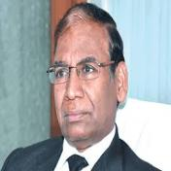
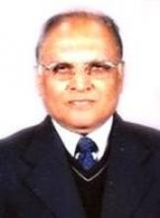
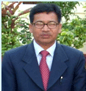

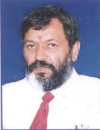
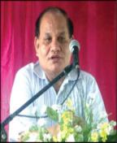
Vice Chancellors with whom CMAI is associated
Dr. Mridul Hazarika
Vice Chancellor
Gauhati University
Prof. R.Lalthantluanga
Vice Chancellor
Mizoram University
Dr. H. Maheshappa
Vice Chancellor
VTU
Dr. Akshai Aggarwal, Vice Chancellor, Gujarat Technological University
Dr. LN Bhagat
Vice Chancellor
Ranchi University
Dr. Akhilesh Kumar Pandey
Chairman
Madhya Pradesh Private University Regulatory Commission
Prof. P.P Mathur
Vice Chancellor
KIIT University
Dr. ADN Bajpai, Vice Chancellor, HP University
Prof. BK Konwar,
Vice Chancellor,
Nagaland University

Slide 5











CMAI PRESENTS
8th international excellence
Education Summit & AWARDS 2014
Supported by
23th October 2014 , FICCI NEW DELHI
Last Year Awards were presented by
Dr. Hamadoun Toure, Secretary General ITU
Prof. Tim Unwin, CEO CommonWealth Telecommunications Org
Mr. Kapil Sibal , Minister for Communications & IT
Dr. Mukul Sangma, Chief Minister Meghalaya
Prof SS Mantha , Chairman AICTE
DOT Govt . Of India.
DIT Govt. Of
India.
Ministry of MNRE
Government of India
Knowledge
Partner
United Nations Office
for Partnerships

Slide 6
ABOUT
CMAI ASSOCIATION OF INDIA
CMAI Association of India is a apex premier and foremost non-profit trade promotion organization based in India with more then 54 MOU partners and representatives spread across globe. CMAI is prominent trade association promoting growth in communications, manufacturing trade sector through Legislative and Regulatory Advocacy, Research, Exhibitions, Trade shows, Conferences and Seminars, Technology events, Buyer sellers meets, B2B meetings, promotion and fostering business and strategic relationships.
CMAI is the only trade organization bringing in focuses harmony in between manufacturing across all sectors including ICT, Communications, Multimedia and Environmental Management policies.
CMAI has been organizing events/ conferences/ Seminars/ exhibitions etc alongwith DOT, DeIT, MNRE, MSME, law ministry for last more than 10 years. Our event has been attended by various Ministers and VIP’s such as –
Hon’ble Mr. Kapil Sibal
Hon’ble Mr. Farooq Abdullah
Hon’ble Mr. Sachin Pilot
Hon’ble Mr. Jyotiraditya Scindia
Hon’ble Mr. Mukul Sangma
Hon’ble Mr. Gurudas Kamat

Slide 7

Hon’ble Mr. Shakil Ahmed
Hon’ble Mr. Tapan Sikdar
Hon’ble Mr. Karia Munda
Hon’ble Mr. Vincent Pala
Hon’ble Mr. Prithvi Raj Chauhan
Other VIP’s at NTA ICT World Communication Summit & Awards
Hon’ble Shri SS Mantha, Chairman AICTE
Hon’ble Shri Mukul Sangma, Chief Minister, Meghalaya
Hon’ble Shri Sk Kak, Vice Chancellor, MTU
Hon’ble Shri DS Chauhan, President Association of Indian Universities,
Secretary DOT, Secretary MNRE, Chairman TRAI etc
About 37 Ambassadors participate in NTA ICT World Communication Awards in 2012 & 2013.
CMAI assists in promotion of technology innovations, manufacturing and communications sector and for policies concerning environmental, pollution and health. CMAI, as a professional registered association, has become extremely pro-active, forward looking and effective catalyst between the Government, industry and the consumers at large.

Slide 8
CMAI has been successful in influencing the Government in shaping India's economic, trade, fiscal and social policies which will be of benefit to the country as a whole and the trade and industry in particular. CMAI caters services to various constituents comprising multinational companies, top corporate, medium and small scale units representing and striving hard to create a conducive environment for the businesses to compete globally. It assists manufacturers to maximize competitiveness on the domestic and international markets.
Actively engaged in ICT, Mobile, Telecom, Education, Alternate Energy, Multimedia, Infrastructure & Education Sectors. Ten China offices & in several other Countries including USA, UK, Taiwan, Korea, Singapore, Bangkok etc. Known for delegations to various Countries and receiving incoming delegations. Providing generally one way/two way air fare, free hotel stay etc.
Representing on more than 100 Government Committees, Groups and very deeply involved in Policy Formulations on Telecom, Mobile, IT, Education.
Industry Academic Interface, Guest Speaker, National Vocational Courses with AICTE/MHRD in Institutes
Signature events are NTA ICT World Communication Awards and National Education Awards (at National and State Levels), presented by Secretary General, International telecom Union, Geneva; Head of Commonwealth Telecom organization, UK, Ministers from India, Africa etc. And ICOMM, the only exhibition for mobiles held every year in India, China at Shenzhen and Shanghai.
As a hobby and CSR, known for spiritual life, meditation, yoga, Reiki, Spiritual therapy, psychic healing, excellence in life, Conflict/Stress management, personality development etc.

Slide 9


































CMAI Members
Operators
Handset
Brands
SZEIA
SMCA
Int’l
Partners
Associations
Universities

Slide 10
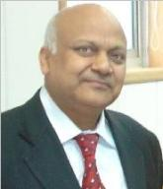
N K Goyal – ‘The Force Behind’
Mr. N K Goyal, President, is the force behind the worldwide strong
establishment of CMAI.
Popularly known as ‘NKG’ in the trade circles, he carries a glowing 41 years of experience and is considered a “live walking
encyclopedia” in the Technology Arena.
A Post-Graduate in Science, with rich experience in Telecom/IT, He has presented papers on topics of public concern e.g. Mobile Handsets, Wireless Communication, Infocom Research & Development, Telecom & IT, Manufacturing, Radiation etc. on International and National stages. NKG is actively involved in policy formulations and development of industrial policies, especially related to Telecom, Mobile and IT Sectors.

Slide 11

National Education Awards
CMAI
Association Of India
CMAI is organizing National Education and 8th NTA ICT World Communication Awards on 23rd September 2014. As a subset to that CMAI is organizing State Level Awards. The first Twelve State Awards i.e National Uttarakhand Education Summit & Awards, National Madhya Pradesh Education Summit & Awards, National Gujarat Education Summit & Awards, National UP Education Summit & Awards , National Punjab Education Summit and Awards, National Haryana Education Summit and Awards, National Andhra Pradesh Education Summit & Awards, National Jharkhand Education Summit & Awards 2014, National Himachal Pradesh Education Summit & Awards, National Assam Education Summit & Awards, National MP Technical Excellence Education Summit & Awards 2014, National Odisha Education Summit & Awards 2014 & National Karnataka Education Summit & Awards 2014 has been jointly organized by Uttarakhand Technical University, RGPV University, GTU-Ahmedabad, MTU Technical University, Noida, Punjab Technical University, GJU University- Hisar, Jawaharlal Nehru Technological University, Anantapur ,Ranchi University, Ranchi, HP University,Shimla, Gauhati University, Guwahati, MP Private University Regulatory Commission, KIIT University, Odisha & Visveswaraya Technological University & CMAI Association of India and supported by AICTE, Ministry Of MNRE , MSME, NIELIT, AIU, DeIT on 11th February, 2013 at Dehradun & 19th March 2013 at Bhopal, 18th March at Gujarat, 19th August 2013 at Noida,15th November 2013 at Chandigarh, 1st Feb 2014 at Hisar, 1st March 2014 at Anantapur, 24th March 2014 at Ranchi, 19th April 2014, 26th April 2014, 27th May 2014, 26th July 2014 & 9th August 2014. The next are planned in Nagaland, Mizoram, Gujarat and would be followed in other States.
The awards in Dehradun were graced by by Hon’ble Sh Vijaya Bahugana, CM, Uttarakhand, Prof. Dr. DS Chauhan, Vice Chancellor, Uttarakhand Technical University; Sh RC Pathak, IAS Secretary Science and Technology Uttarakhand Government, and Representative of AICTE.

Slide 12
CMAI
Association Of India
National Education Awards
The Awards in Madhya Pradesh were graced by Hon’ble Shri Kailash Vijayvargia, Minister for Science and Technology, IT, Hon’ble Shri Laxmikant Sharma, Minister of Technical Education & Higher Education, Hon’ble Shri Mahendra Hardia, Minister of State for Technical Education,Hon’ble Prof. Piyush Trivedi,Vice Chancellor, Rajiv Gandhi Proudyogiki Vishwavidyalaya.
The awards in Noida was graced by Hon’ble Abhishek Mishra,Minister of Science & Technology, UP , Prof SK Kak VC, SS Mantha, Chairman AICTE, Ashwani Kumar, MD, NIELIT
In Punjab the Awards were graced by Hon’ble Chuni lal Bhagat, Minister for Forest Wildlife and Labour & Hon’ble Madan Mohan Mittal, Minister for higher Education and Industrial Training.
The Awards in Haryana were presented by Hon’ble Commissioner Yudhbir Singh Khyalia, Hisar Division, Shri KL Johar, Co- Founder VC GJU.
The Awards in Andhra Pradesh were presented by Hon’ble Prof. Y Venkatarami Reddy, Former Member UPSC & Hon’ble Prof. K lal Kishore, Vice Chancellor Jawaharlal Nehru Technological University, Anantapur.

Slide 13
CMAI
Association Of India
National Education Awards
The Awards in Jharkhand were presented by Hon’ble Prof. Dr. L.N Bhagat, Vice Chancellor, Ranchi University, Shri Nalin Kumar, OSD (J) to the Hon’ble Governor Jharkhand, Dr A.K Pandey, IAS, Additional Chief Secretary Sci & Tech, Govt. of Jharkhand & DG Shri Krishna Institute of Public Administration.
The Awards in Himachal were presented by Hon’ble Dr. Prof. A.D.N. Bajpai, Vice Chancellor, Himachal Pradesh University, Shimla ; Hon’ble Mrs Suneeta Mukherjee, IAS ( Retd.) Former UNFPA representative; Mr. Yogesh Kocchar, Director Microsoft, Mr. Suneet Tuli, CEO Datawind and Mr. Saket Modi, CEO Lucideus
The Awards in Assam were presented by Hon’ble Dr. Prof. Mridul Hazarika, Vice Chancellor, Gauhati University, Guwahati ; Hon’ble Shri Rajiv kr. Bora, IAS, Principal Secretary of Assam for Information & Technology; Mr. Suneet Tuli, CEO Datawind and Mr. Saket Modi, CEO Lucideus
The Awards in MP were presented by Hon’ble Shri Akhilesh K. Pandey,Chairman, MP Private University Regulatory Commission, Bhopal, Hon’ble Shri Akshai Aggarwal VC Gujarat Technological University, Hon’ble Shri Pramod Verma, Director General, MP Council of Science & Technology, Hon’ble Shri R.S Rathore, Deputy Director, All India Council of Technical Education & from Industry Mr. Nikhil Buran, Enterprise Business Manager, HP India

Slide 14
CMAI
Association Of India
National Education Awards
The Awards in Orissa were be presented by a galaxy of VIPs - Hon’ble Dr. Pradeep Kumar Panigrahi, Minister of State (Independent) for Higher Education, Science & Technology & Rural Water Supply, Government of Odisha, Hon’ble Shri Dr. Achyuta Samanta, Founder, KIIT & KISS, Hon’ble Dr. P.P Mathur, Vice Cancellor, KIIT University,Hon'ble Prof. NK Goyal, President, CMAI Association of India.
The Awards in Karnataka were presented by a galaxy of VIPs Hon’ble Shri Arvind Jadhav, IAS, Additional Chief Secretary & Chairman – KSTDC, Government of Karnataka; Hon’ble Dr. H. Maheshappa, Vice Chancellor, Visvesvaraya Technological University; Hon’ble Prof Prasad, Registrar VTU, Hon’ble Prof. Shri NK Goyal, President CMAI Association of India and from Industy Mr. Krishnan Ramanathan, Data Scientist, HP Technologies;
Several officials from University, Telecom & IT Associations of India will be participating in this event, which will be extensively covered by the media.

Slide 15
CMAI
Association Of India
The Objective
In India there are hundreds of private colleges and institutions which have come up across the country offering a number of courses in various streams like engineering, medical, business management and many more. This rapid pace of growth has brought to the fore compelling issue of effective management of the educational programs so as to better prepare our youngsters for the fast evolving competitive environment.
There are institutes who are focusing their energies on overall quality of education and making their students more employable so that they can make meaningful contribution towards making India a true superpower in the coming years.
We would like to recognize the achievement of some of these institutions who have contributed significantly towards the growth of the education sector in India in the recent times for their betterment of Work in future.

Slide 16
CMAI
Association Of India
CMAI National Education Summit & Awards Events Details
(Approximately 20-25 every year).
National Jharkhand Education Summit & Awards on 24th March 2014
National Himachal Education Summit & Awards on 19th April 2014
National Assam Education Summit & Awards on 26th April 2014
National MP Education Excellence Summit & Awards on 27th May 2014
National Gujarat Education Summit & Awards 2014 on 19th July 2014
National Odisha Education Summit & Awards 2014 on 26th July 2014
National Karnataka Education Summit &Awards 2014 on 9th August 2014
1- Events already held
National Uttarakhand Education Summit & Awards
National Madhya Pradesh Education Summit & Awards
National Uttar Pradesh Education Summit & Awards
National Punjab Education Summit & Awards
National Haryana Education Summit & Awards
National Gujarat Education Summit & Awards
National Andhra Pradesh Education Summit & Awards on 1st March 2014

Slide 17
CMAI
Association Of India
CMAI National Education Summit & Awards Events Details
(Approximately 20-25 every year).
2 - Events Finalized
National Legal Education Summit & Awards
National Nagaland Education Summit & Awards
National Mizoram Education Summit & Awards
3 - Events in Pipeline
• National Maharashtra Education Summit & Awards
• National Rajasthan Education Summit & Awards
• National UP ( Bundelkhand) Education Summit & Awards
• National Tamil Nadu Education Summit & Awards
• National Bihar Education Summit & Awards
• National Kerela Education Summit & Awards
• National Arunachal Pradesh Education Summit & Awards
• National Chhattisgarh Education Summit & Awards
• National Goa Education Summit & Awards
• National Jammu & Kashmir Education Summit & Awards
• National Kerela Education Summit & Awards
And More…….

Slide 18
CMAI
Association Of India
Some
Pictures of National Education
Awards
Held on 7th May 2013
At New Delhi FICCI Auditorium

Slide 19
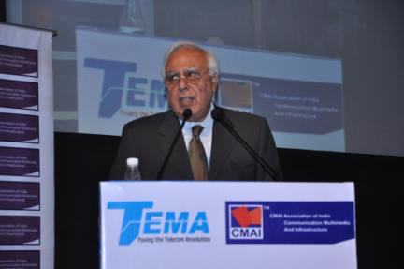
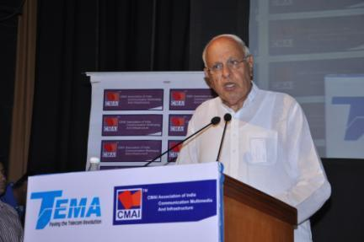
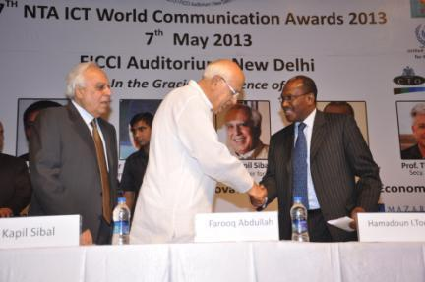
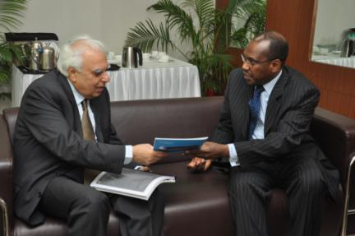
CMAI
Association Of India
Hon’ble Minister Shri Kapil Sibal, MOCIT
Addressing the Audience
Hon’ble Minister Dr Farooq Abdullah ,MNRE
Addressing the Audience
Hon’ble Shri Kapil Sibal & Hon’ble Dr. Farooq Abdullah with ITU Secretary General Geneva, Shri Hamadoun Toure
Hon’ble Shri Kapil Sibal with ITU Secretary General Geneva, Shri Hamadoun Toure

Slide 20
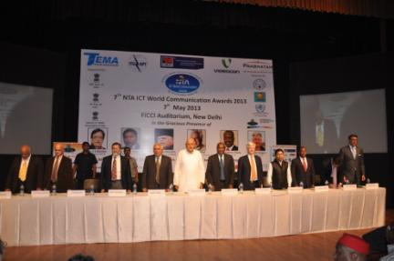
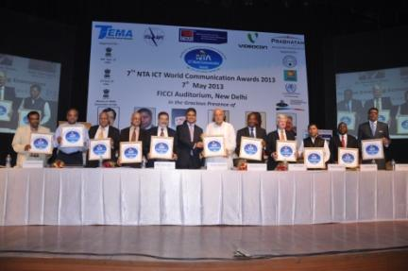
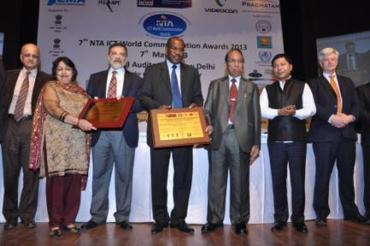
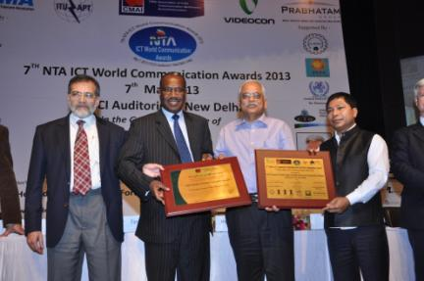
CMAI
Association Of India

Slide 21

CMAI
Association Of India
Some
Pictures of National Uttarakhand Education Summit &
Awards
Held on 11th Feb 2013
At Dehradun.

Slide 22
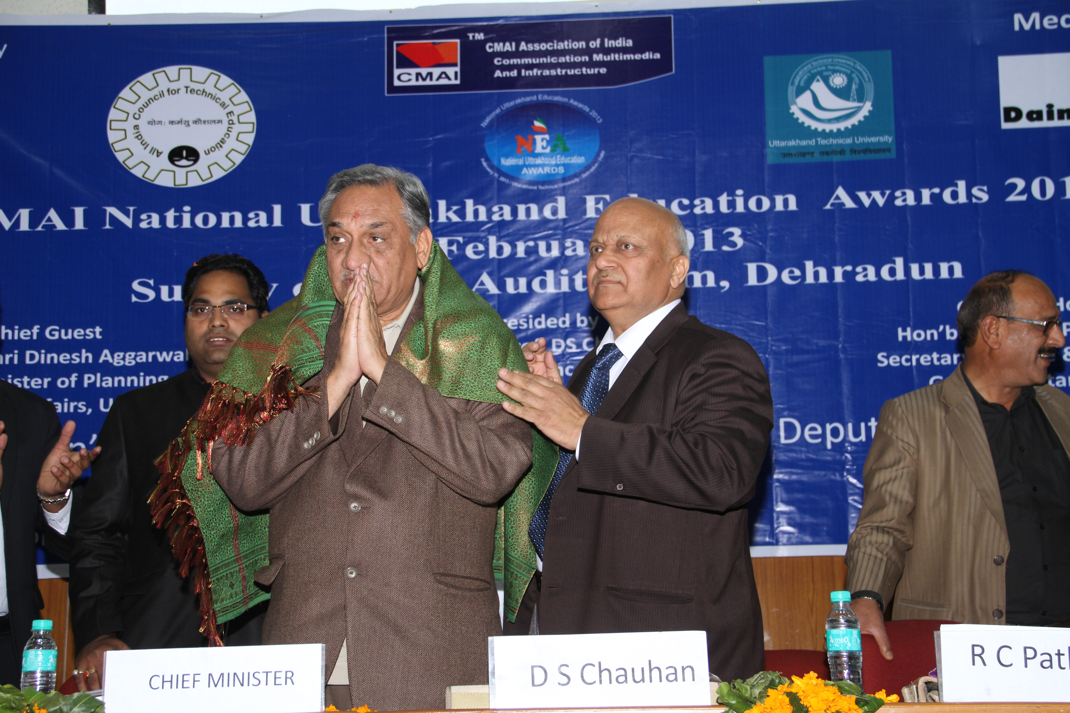
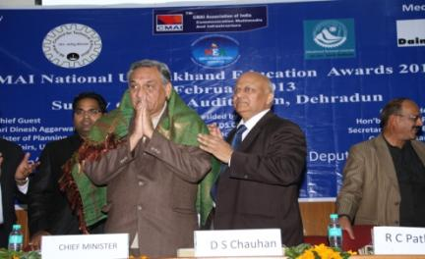
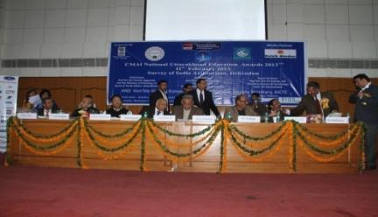
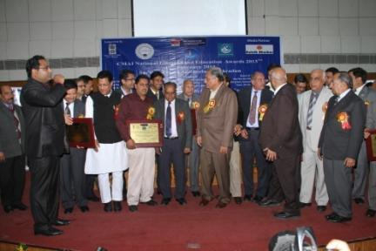
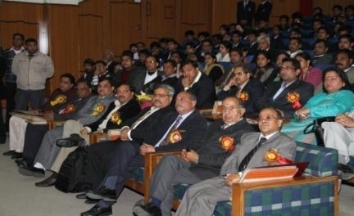
CMAI
Association Of India
Shri NK Goyal, President CMAI Felicitating
Shri Vijay Bahuguna Chief Minister Uttarakhand
VIPS on the DIAS
Group Photo with CM
Audiences at NUEA

Slide 23
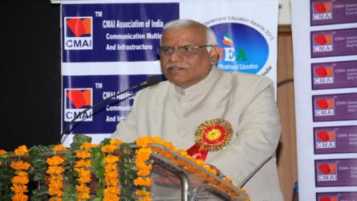
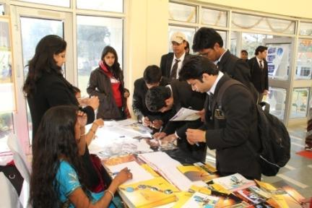
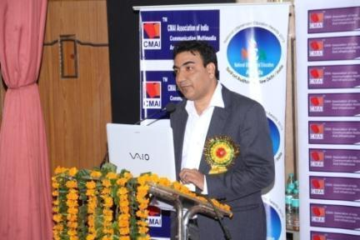
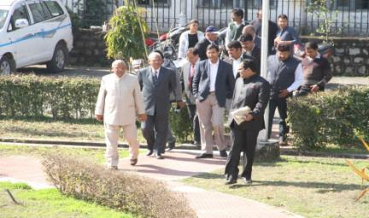
CMAI
Association Of India
Prof DS Chauhan Addressing , Vice Chancellor UTU
Registration
Shri RS Rathore Addressing , Deputy Secretary AICTE

Slide 24

CMAI
Association Of India
Department of MNRE
Govt . Of India.
Some
Pictures of National Madhya Pradesh Education
Awards
Held on 19th March 2013
At Bhopal.

Slide 25
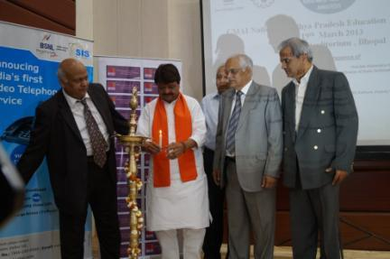
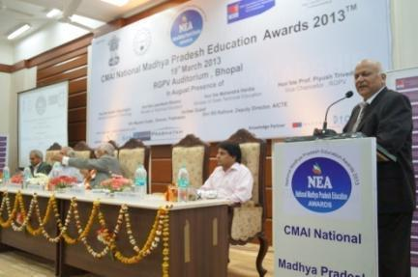
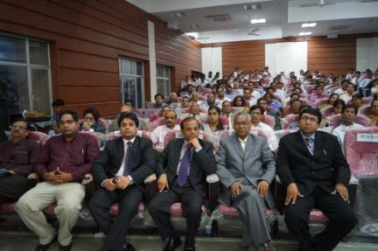
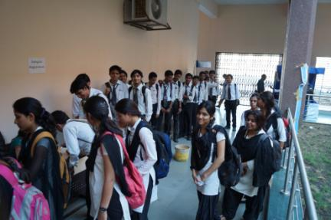
Hon’ble Shri Kailash Vijayvargiya, Minister of State for IT, Sc & Tech. & Employment
Prof. NK Goyal President CMAI welcoming VIPs on the dais at National MP Education Summit & Awards
Audience attending the Award Show

Slide 26
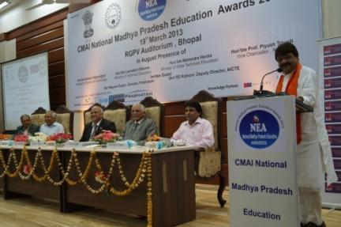
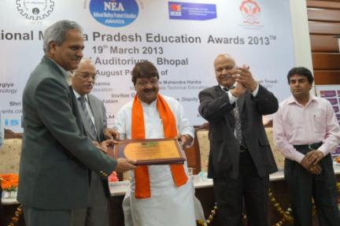
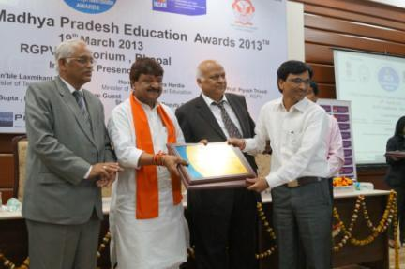
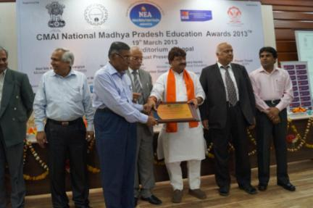
Hon’ble Shri Kailash Vijay Vargiya Addressing the delegates and giving away awards with Prof. Piyush Trivedi VC, RGPV at National MP Education Summit & Awards

Slide 27
CMAI
Association Of India
Department of MNRE
Govt . Of India.
Some
Pictures of National UP Education
Summit & Awards
Held on 19th August 2013
At Noida, UP.

Slide 28
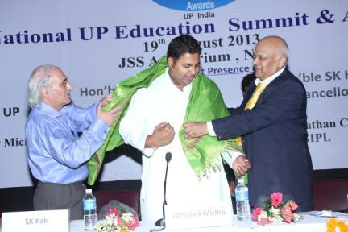
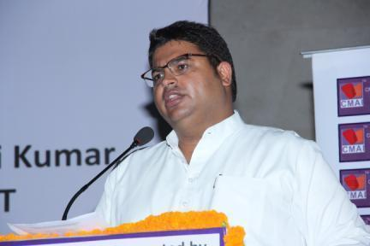
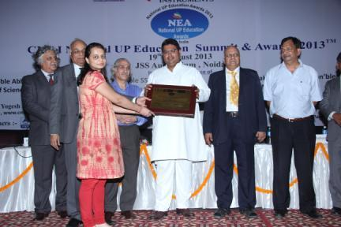
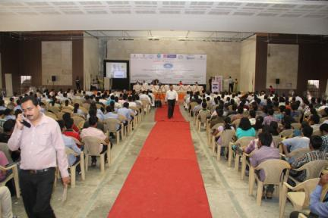
Felicitating & Addressing to delegates by Hon’ble Shri Abhishek Mishra, Minister of State for Protocol , UP with Prof. SK Kak, VC, MTU

Slide 29
CMAI
Association Of India
Department of MNRE
Govt . Of India.
Some
Pictures of National Punjab Education Summit &
Awards
Held on 15th November 2013
At Chandigarh.

Slide 30
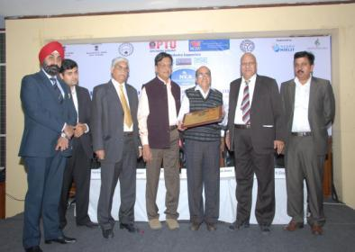
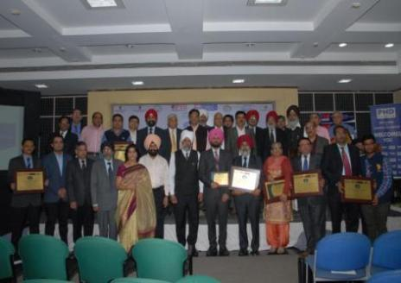
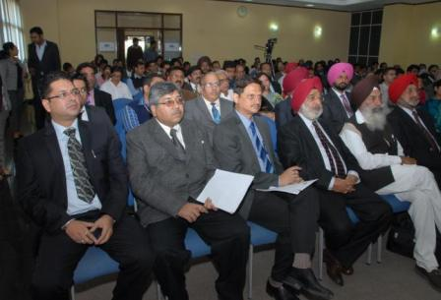

Hon’ble Shri SS Mantha, Chairman AICTE & Hon’ble Dr. Rajneesh Arora, Vice Chancellor, PTU at National Punjab Education Summit & Awards

Slide 31
CMAI
Association Of India
Department of MNRE
Govt . Of India.
Some
Pictures of National Haryana Education Summit &
Awards
Held on 1st February 2014
At Hisar Haryana.

Slide 32




Hon’ble Commissioner Yudhbir Singh Khyalia, Hisar Division
being felicitated by Shri NK Goyal, President CMAI
Hon’ble M L Ranga, VC GJU
being felicitated by Shri NK Goyal, President CMAI
Awardees
Audiences at NHESA

Slide 33
CMAI
Association Of India
Department of MNRE
Govt . Of India.
Some
Pictures of National Andhra Pradesh Education Summit &
Awards
Held on 1st March 2014
At Anantapur.

Slide 34




The Awards in Andhra Pradesh were presented by Hon’ble Prof. Y Venkatarami Reddy, Former Member
UPSC & Hon’ble Prof. K lal Kishore, Vice Chancellor Jawaharlal Nehru Technological University, Anantapur

Slide 35
CMAI
Association Of India
Department of MNRE
Govt . Of India.
Some
Pictures of National Jharkhand Education Summit &
Awards
Held on 24th March 2014
At Ranchi.

Slide 36




The Awards in Jharkhand were presented by Hon’ble Prof. Dr. L.N Bhagat, Vice Chancellor, Ranchi University, Shri Nalin Kumar, OSD (J) to the Hon’ble Governor Jharkhand, Dr A.K Pandey, IAS, Additional
Chief Secretary Sci & Tech, Govt. of Jharkhand & DG Shri Krishna Institute of Public Administration.

Slide 37
CMAI
Association Of India
Department of MNRE
Govt . Of India.
Some
Pictures of National Himachal Pradesh Education Summit &
Awards
Held on 19th April 2014
At Shimla.

Slide 38




The Awards in Himachal were presented by Hon’ble Dr. Prof. A.D.N. Bajpai, Vice Chancellor, Himachal Pradesh University, Shimla ; Hon’ble Mrs Suneeta Mukherjee, IAS ( Retd.) Former UNFPA representative; Mr. Yogesh Kocchar, Director Microsoft

Slide 39
CMAI
Association Of India
Department of MNRE
Govt . Of India.
Some
Pictures of National Assam Education Summit &
Awards
Held on 26th April 2014
At Guwahati.

Slide 40




Awards in Assam were presented by Hon’ble Dr. Prof. Mridul Hazarika, Vice Chancellor, Gauhati University, Guwahati ; Hon’ble Shri Rajiv kr. Bora, IAS, Principal Secretary of Assam for Information & Technology

Slide 41
CMAI
Association Of India
Department of MNRE
Govt . Of India.
Some
Pictures of National MP Technical Excellence Education Summit &
Awards
Held on 27th May 2014
At Bhopal.

Slide 42




Awards in MP were presented by Hon’ble Shri Akhilesh K. Pandey,Chairman, MP Private University Regulatory Commission, Bhopal, Hon’ble Shri Akshai Aggarwal VC Gujarat Technological University, Hon’ble Shri Pramod Verma, Director General, MP Council of Science & Technology, Hon’ble Shri R.S Rathore, Deputy Director, All India Council of Technical Education & from Industry Mr. Nikhil Buran, Enterprise Business Manager, HP India

Slide 43
CMAI
Association Of India
Department of MNRE
Govt . Of India.
Some
Pictures of National Odisha
Education Summit &
Awards
Held on 26th July 2014
At Bhubaneswar

Slide 44




The Awards in Orissa were be presented by a galaxy of VIPs - Hon’ble Dr. Pradeep Kumar Panigrahi, Minister of State (Independent) for Higher Education, Science & Technology & Rural Water Supply, Government of Odisha, Hon’ble Shri Dr. Achyuta Samanta, Founder, KIIT & KISS, Hon’ble Dr. P.P Mathur, Vice Cancellor, KIIT University,Hon'ble Prof. NK Goyal, President, CMAI Association of India.

Slide 45
CMAI
Association Of India
Department of MNRE
Govt . Of India.
Some
Pictures of National Karnataka
Education Summit &
Awards
Held on 9th October 2014
At Bangalore

Slide 46




The Awards in Karnataka were presented by a galaxy of VIPs Hon’ble Shri Arvind Jadhav, IAS, Additional Chief Secretary & Chairman – KSTDC, Government of Karnataka; Hon’ble Dr. H. Maheshappa, Vice Chancellor, Visvesvaraya Technological University; Hon’ble Prof Prasad, Registrar VTU, Hon’ble Prof. Shri NK Goyal, President CMAI Association of India and from Industy Mr. Krishnan Ramanathan, Data Scientist, HP Technologies

Slide 47
CMAI
Association Of India
Some
Pictures of CCI Technology Education Excellence Awards 2013
Held on
18th May 2013

Slide 48




Hon’ble Shri Ndubuishi V. Amaku, Ambassador of Nigeria & Hon’ble Dr. Akshai Aggarwal, Vice Chancellor, GTU with Prof. NK Goyal President CMAI

Slide 49
CMAI
Association Of India
Some
Pictures of 6th National Education
Awards At
6th National Telecom Awards
Held on
8th May 2012

Slide 50


CMAI
Association Of India
Award presented by (from left to right)- Prof. SS Mantha, Chairman AICTE, Dr. Hamadoun Toure, Secretary General ITU, Mr. Girish Pradhan, Secretary, MNRE
Visionary ICT Leader in Education
Prof DS Chauhan,
Vice Chancellor,
Uttarakhand Technical University

Slide 51


CMAI
Association Of India
Award presented by (from left to right)- Prof. SS Mantha, Chairman AICTE, Dr. Hamadoun Toure, Secretary General ITU, Mr. Girish Pradhan , Secretary, MNRE
Pioneering ICT Leader in Education
Prof Dr SK Kak,
Vice Chancellor,
Mahamaya Technical University NOIDA

Slide 52


CMAI
Association Of India
Award presented by (from left to right)- Prof. SS Mantha, Chairman AICTE, Dr. Hamadoun Toure, Secretary General ITU, Dr. SK Kak, VC MTU, Prof. DS Chauhan, VC, UTU -
Excellence in Technical Education - Roorkee Institute of Technology.

Slide 53


CMAI
Association Of India
Award presented by (from left to right)- Prof. SS Mantha, Chairman AICTE, Dr. Hamadoun Toure, Secretary General ITU, Dr. SK Kak, VC MTU, Prof. DS Chauhan, VC, UTU
Emerging Institute for ICT
Gyan Ganga Group of Institutions, Bhopal

Slide 54

CMAI
Association Of India
VIPS present at Dias
6th National Telecom Awards 2012

Slide 55
CMAI
Association Of India
National Uttarakhand/ MP/ Gujarat / UP / Punjab/ Haryana/ Andhra Pradesh/ Jharkhand/ Himachal Pradesh/ Assam Education Summit &
Awards 2013/2014
News Coverage

Slide 56









Slide 57











Slide 58




Slide 59


Slide 60




Slide 61




Slide 62
Nagaland University
Department of MNRE
Govt . Of India.
Department of MSME
Govt . Of India.
CMAI National Nagaland Education Summit & Awards 2014
Organized by – CMAI & Nagaland University
Supported By –AICTE, NIELIT, AIU
Govt. Of India, MNRE, DeIT, MSME
Media Partner

Slide 63







CMAI
Association Of India
Recent Exhibitors in CMAI Summit and Awards
And More…

Slide 64







CMAI
Association Of India
Recent Exhibitors in CMAI Summit and Awards
And More…

Slide 65
CMAI
Association Of India
The Awards will be Examined and Certified by –
Dion Global - Dion Global Solutions provides market leading software
solutions to financial institutions across Asia Pacific, Europe, India
South Asia, Americas and the Middle East and Africa. Employing over
600 highly experienced and knowledgeable staff within the Finance and
IT industries, Dion provides portfolio of cutting-edge solutions and
services for the international financial markets.
AND
Mazars - Mazars is a leading independent and integrated international
organization, which specializes in providing assurance, tax and advisory
services. It is also among the leading organizations providing
professional services to large international corporate, SMEs and
individuals in India.
With 550 professional staff we offer our clients the advantage a
nation-wide presence.
They are advisors and auditors to large Indian and International companies.

Slide 66
CMAI
Association Of India
The Awards Jury bill be headed by eminent persons such as
Ex- Secy. Education Govt. of India, Ex- Chairman competition Law,
Ex- Secretary Law, Ex- Chief Secretary Himachal Pradesh,
Ex – Chairman Fera Tribunal , Vice Chancellors of universities etc.
Education and Industry Professionals.

Slide 67


Slide 68



CMAI
Association Of India
To be Supported by-

Slide 69

Thank You
N K Goyal, President CMAI Association of India
nkgoyals@yahoo.co.in : president_cmai@cmai.asia
+919811129879
www.cmai.asia, www.cmaievents.com

